Slide 1

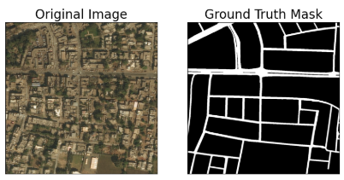
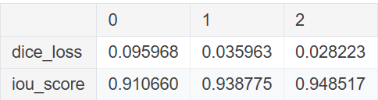
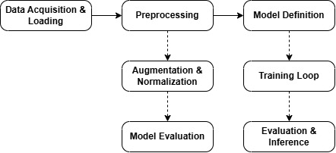
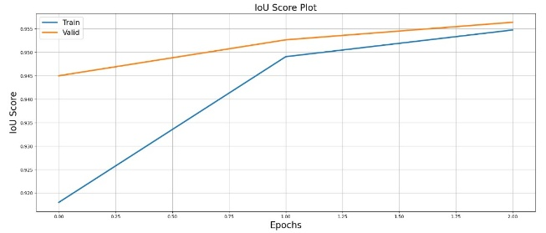
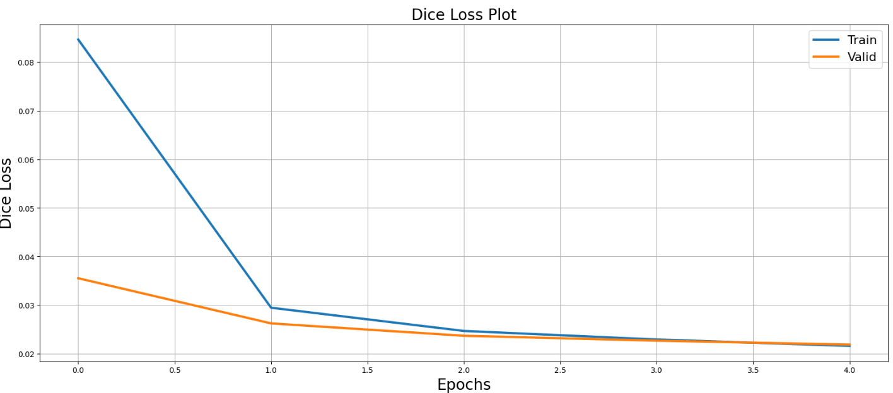
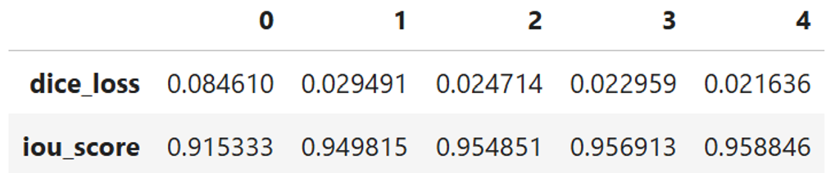
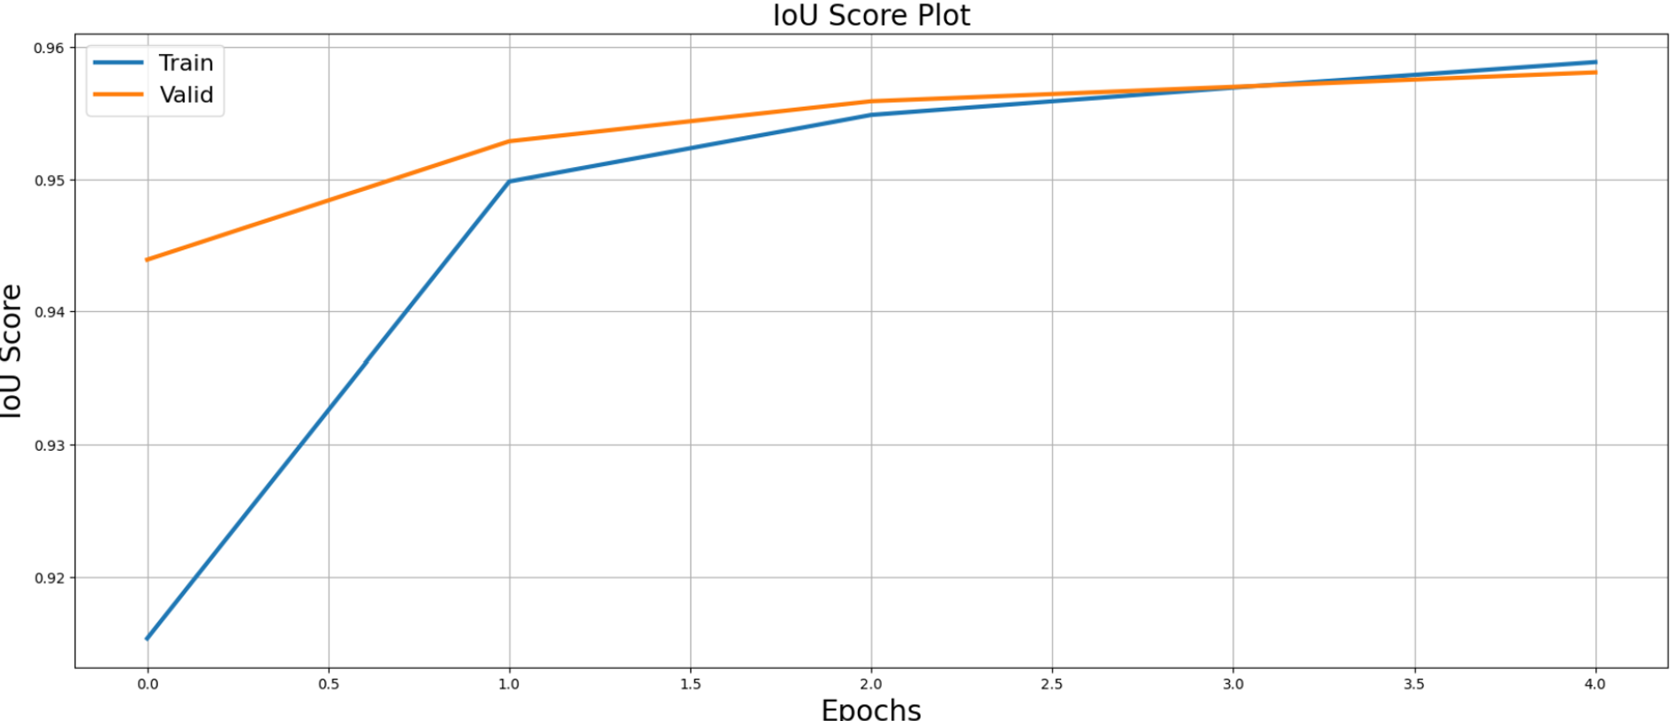
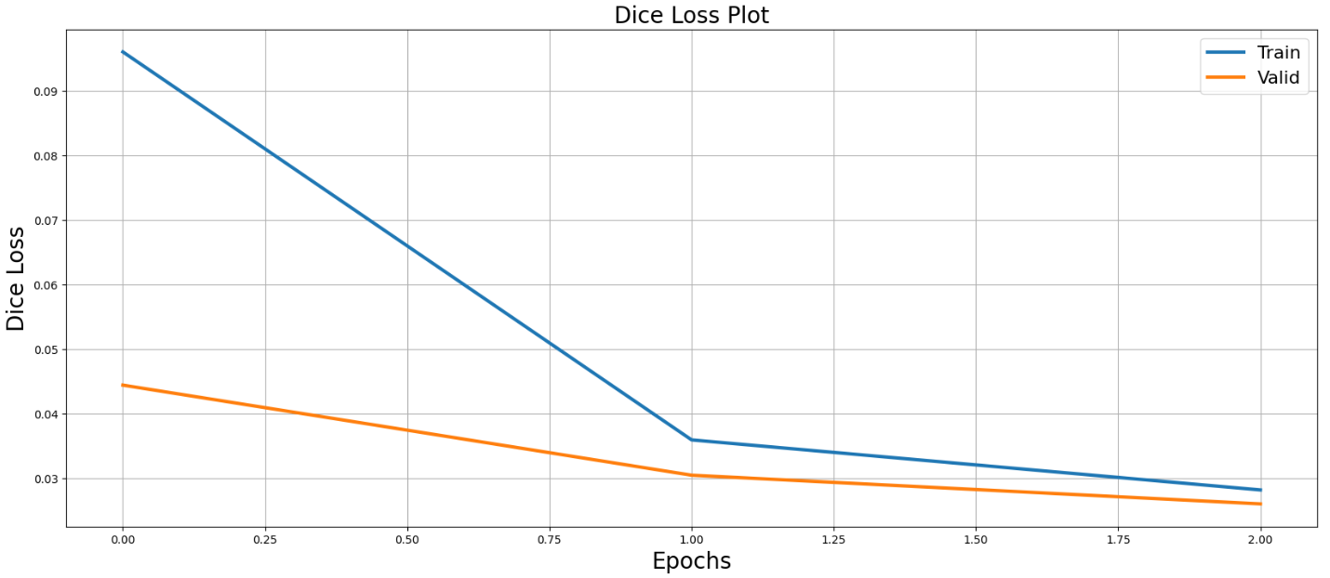
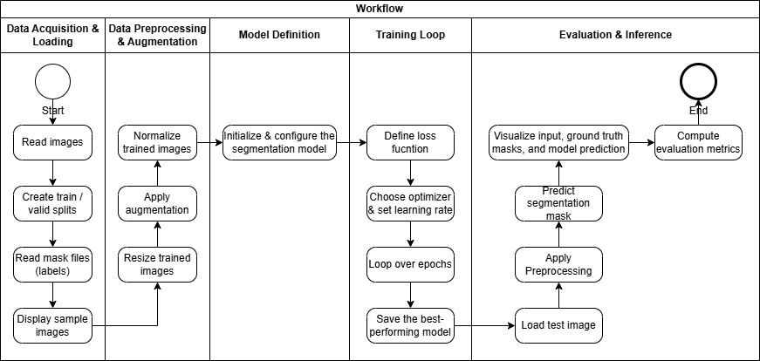
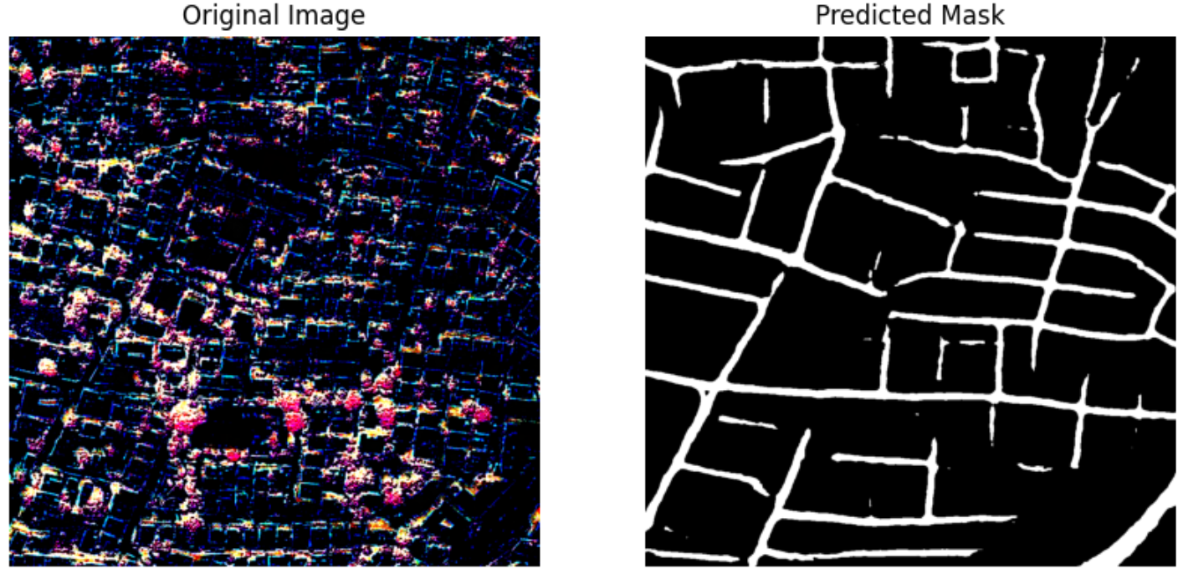
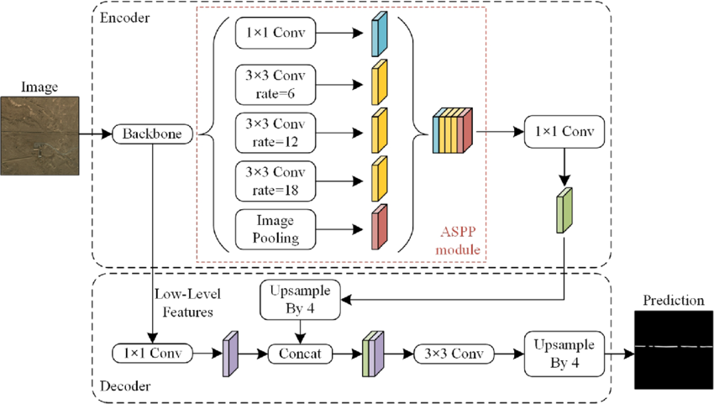
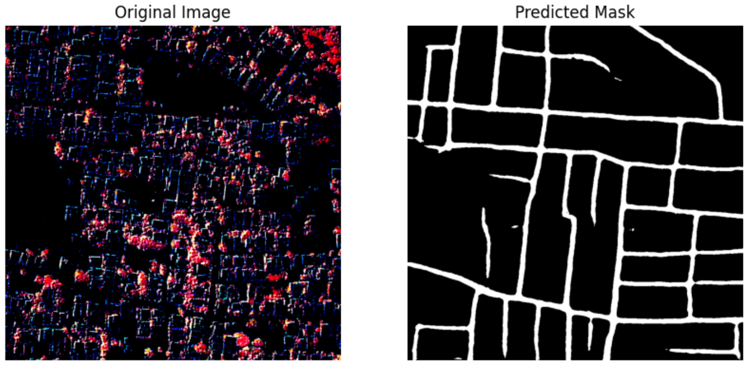
AI-Road Network Extraction From Satellite Imagery
Author: Diep Nguyen + Harnil Patel + Do Thin
Teacher: Himanshu Patel – Saskatchewan Polytechnic
Introduction
Detailed Project Block Diagram
Methodology
Results and Analysis
With the rise of artificial intelligence and deep learning in geospatial applications, automated road extraction from satellite images has become a crucial task for urban planning, navigation, and disaster management. Traditional methods for road segmentation often struggle with occlusions, varying illumination, and complex road structures. This project leverages DeepLabV3+, a state-of-the-art deep learning architecture, to enhance road segmentation accuracy in both urban and rural environments.
Data Collection
Kaggle, containing high-resolution satellite images with road network annotations
(https://www.kaggle.com/datasets/balraj98/deepglobe-road-extraction-dataset/data).
Images: 6,226, Masks: 6,226
Baseline Model
Detailed Data Preprocessing
Import Libraries
Numpy, pandas, torch, cv2, matplotlib
Load the Dataset
Dataset sourced from Kaggle
Albumentations for data augmentation
Segmentation_models_pytorch for deep learning model
Metadata file: metadata.csv
Load using Pandas: pd.read_csv()
Filter for training data
Path Adjustments
Convert relative paths to absolute paths
Data Augmentation
Use Albumentations for transformations: HorizontalFlip, Normalize trained images
Ensure model generalization
Project Objectives
This project implements and evaluates DeepLabV3+ for road segmentation in satellite imagery. The key objectives include:
Utilizing DeepLabV3+'s advanced features to segment roads effectively.
Evaluating performance based on IoU and Dice Coefficient.
Comparing results with U-Net to assess the best-performing model.
Enahance/Optimize the baseline model to Generate reliable segmentation outputs for real-world applications.
Enhancement Model
Modelling
Model Architecture
DeepLabV3+ -
Base Model: DeepLabV3+ with ResNet-50 backbone
Training Configuration
Optimizer: Adam with learning rate scheduling.
Key Features
Atrous Spatial Pyramid Pooling (ASPP) for multi-scale context
Encoder-Decoder structure for high-resolution segmentation
Batch Size: 4
Epochs: 5
Augmentations: Applied to improve generalization.
Hardware: Trained on GPU
Model Evaluation Metrics
Metrics Used
Intersection over Union (IoU)
Dice Coefficient
Pixel Accuracy
Results Visualization
Display sample predictions vs. ground truth masks
Project Flowchart
Validation
Testing
Conclusion
This project successfully implemented DeepLabV3+ for road segmentation, achieving a high IoU score of 0.9518 and a low Dice Loss of 0.0261. The model outperforms U-Net in terms of segmentation accuracy and precision, making it a viable solution for automated road extraction in satellite imagery.

